Slide 1
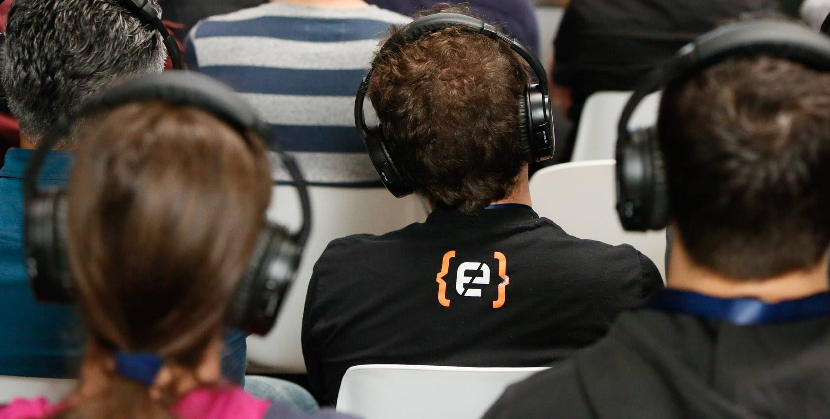
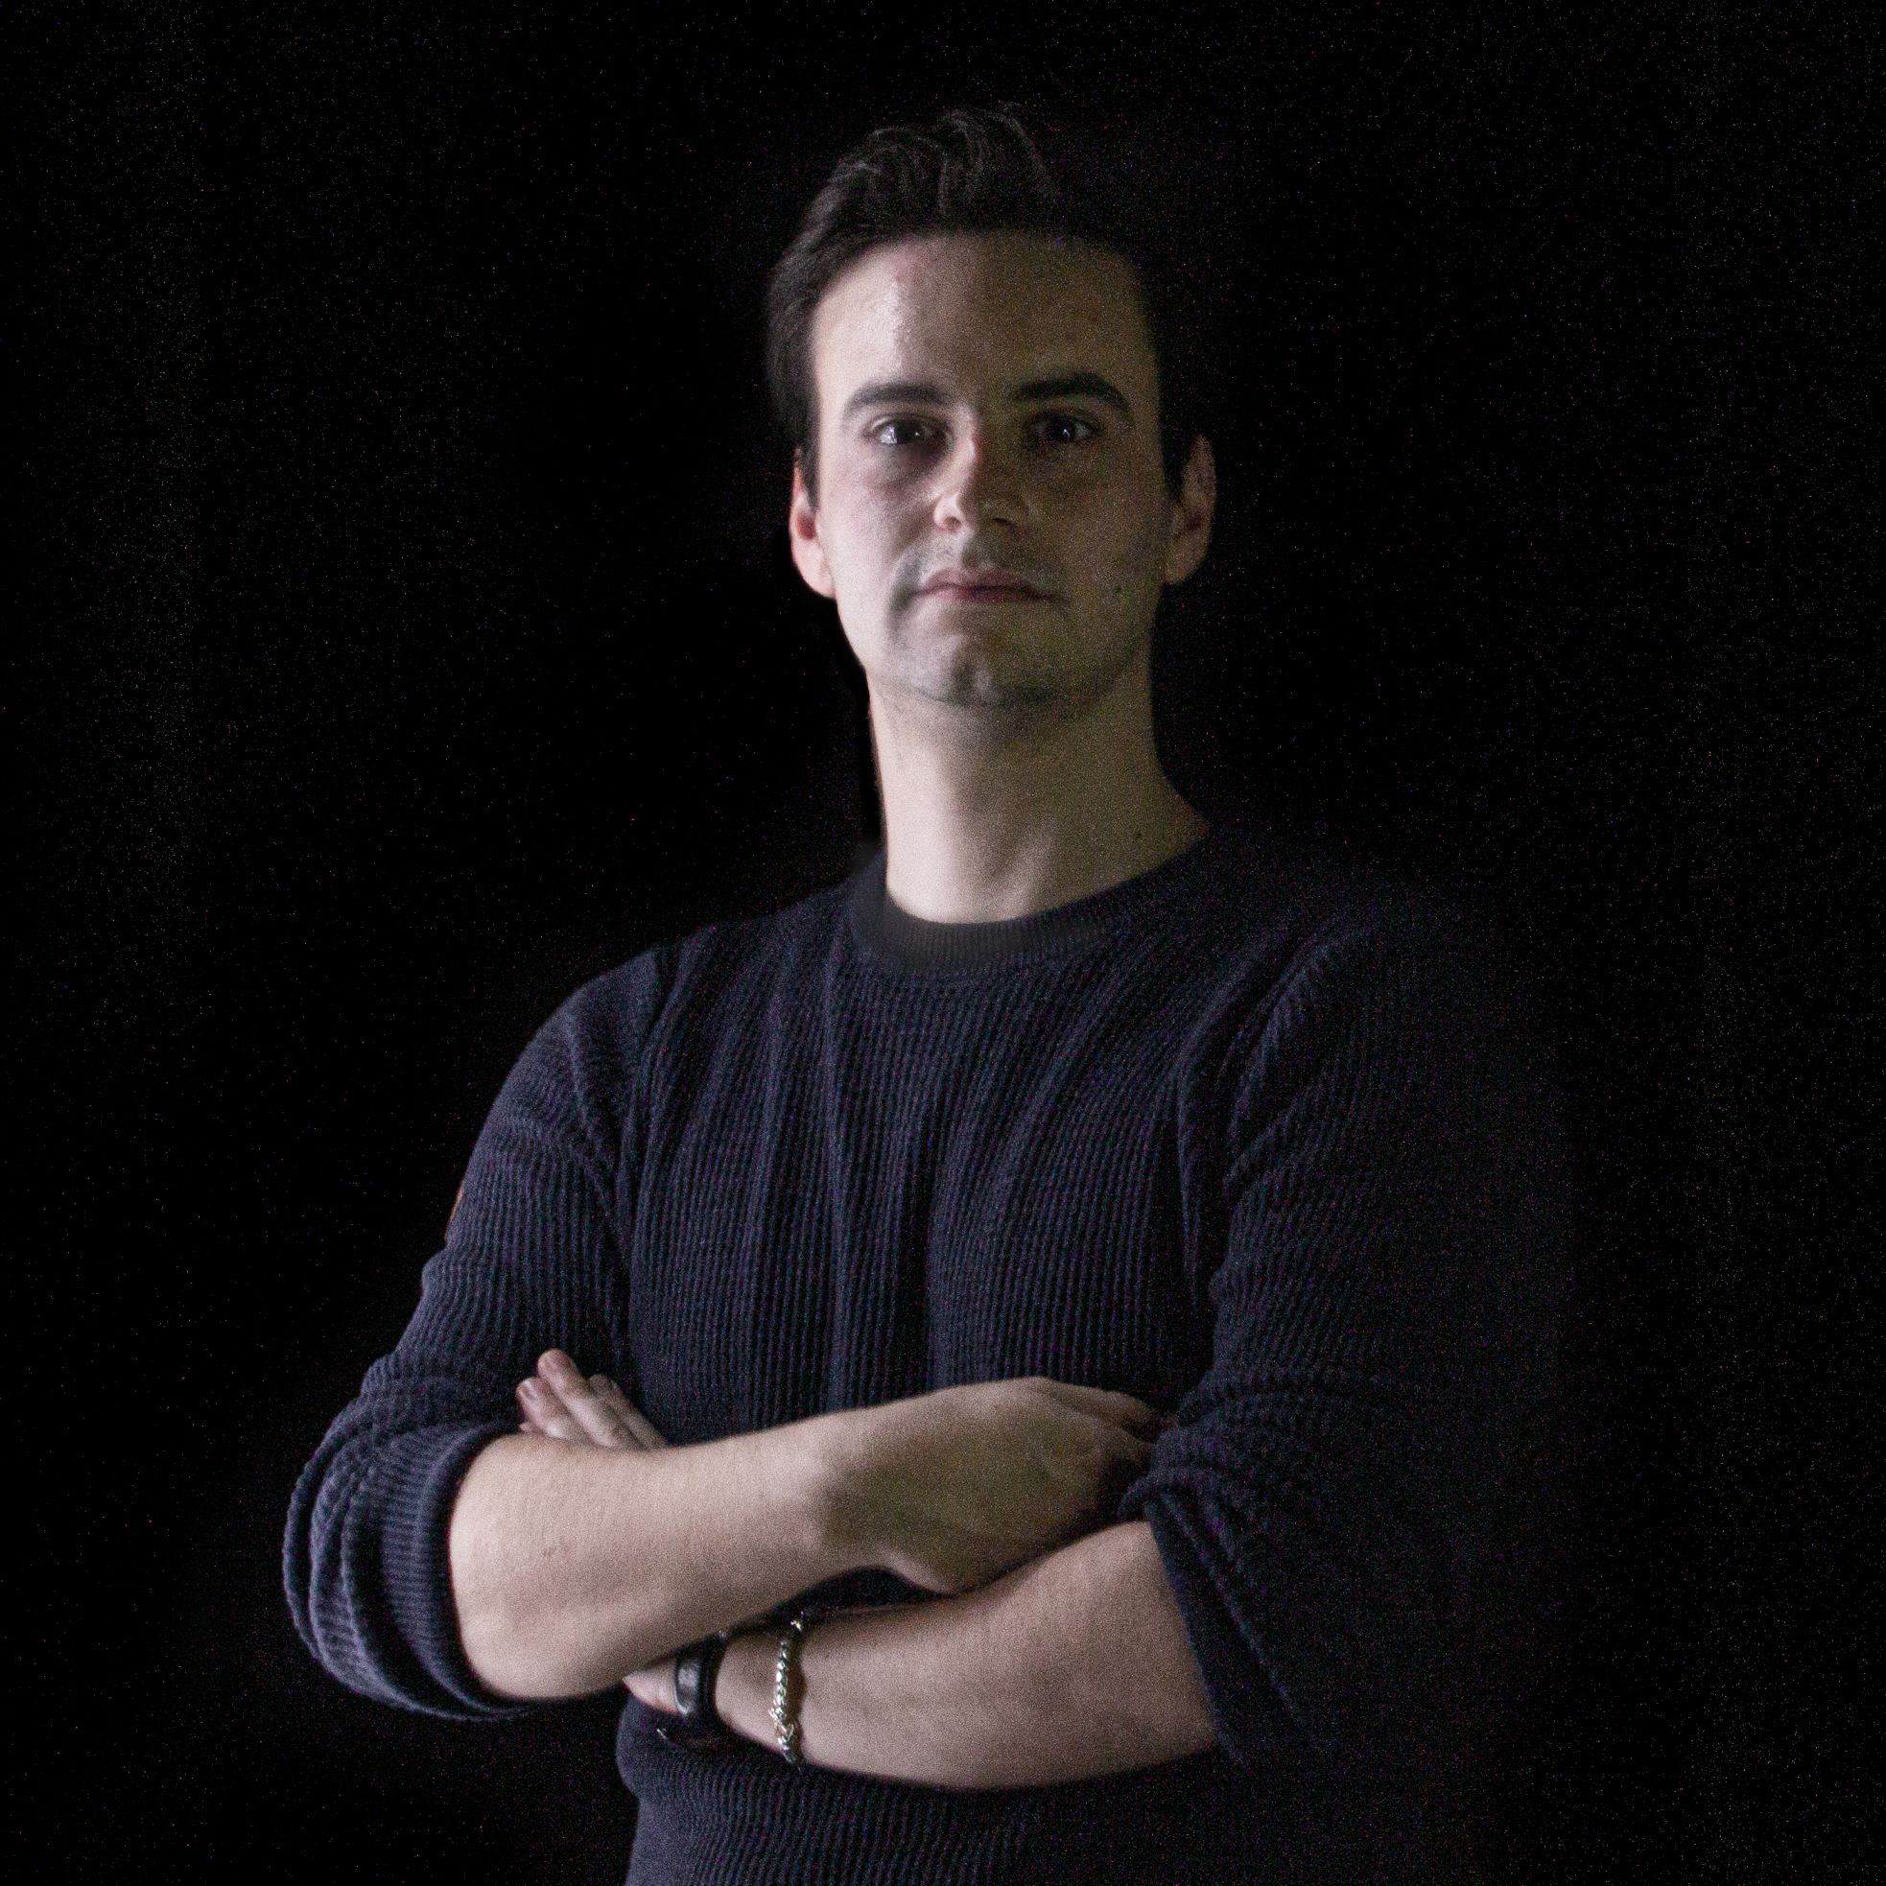



QUANTUM COMPUTING
From Zero To Classification
ALESSANDRO BERTI - Ph.D. student
@University of Pisa
23-24-25 Marzo, 2021

Slide 2
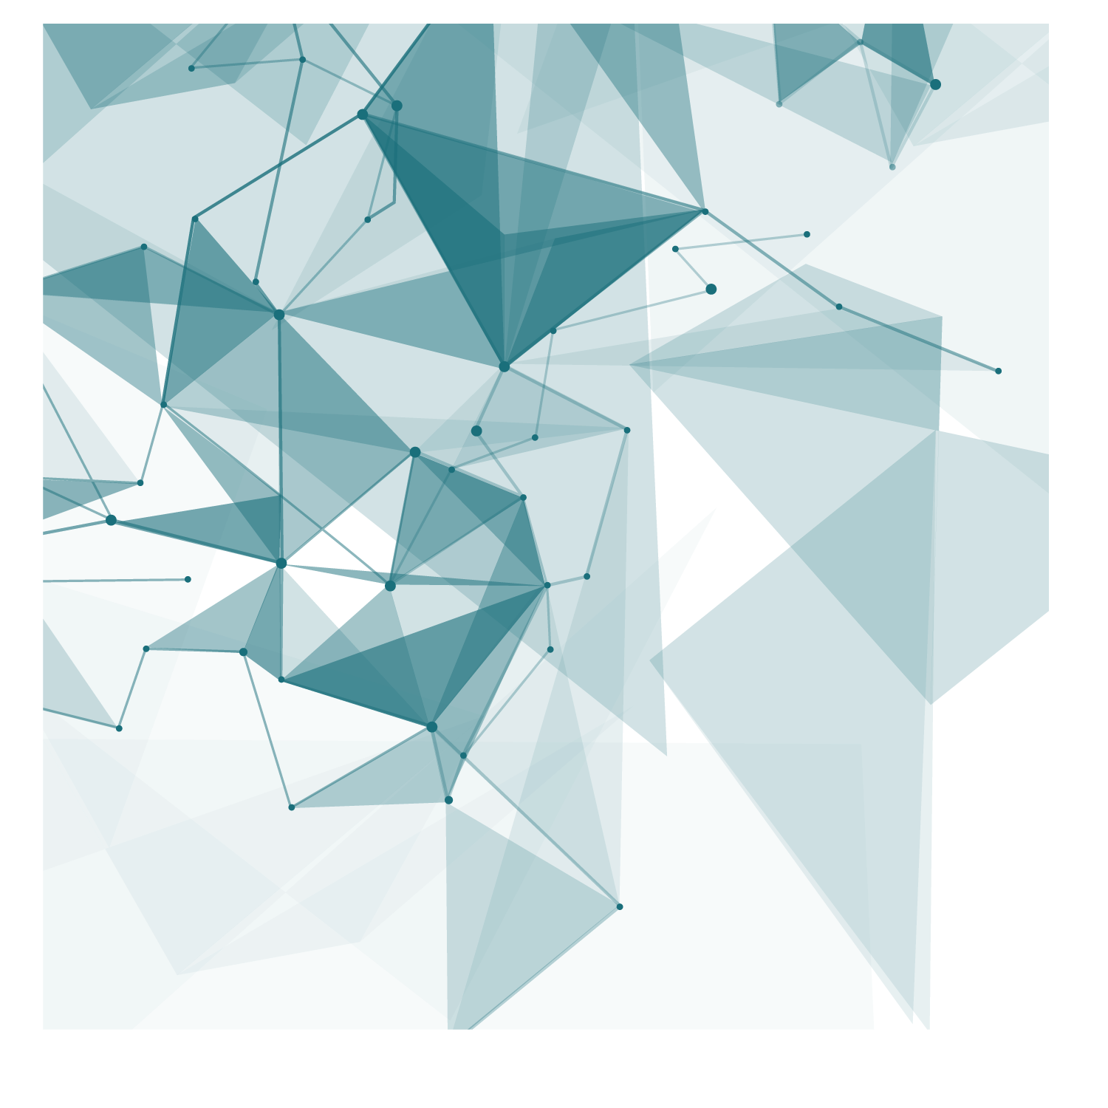
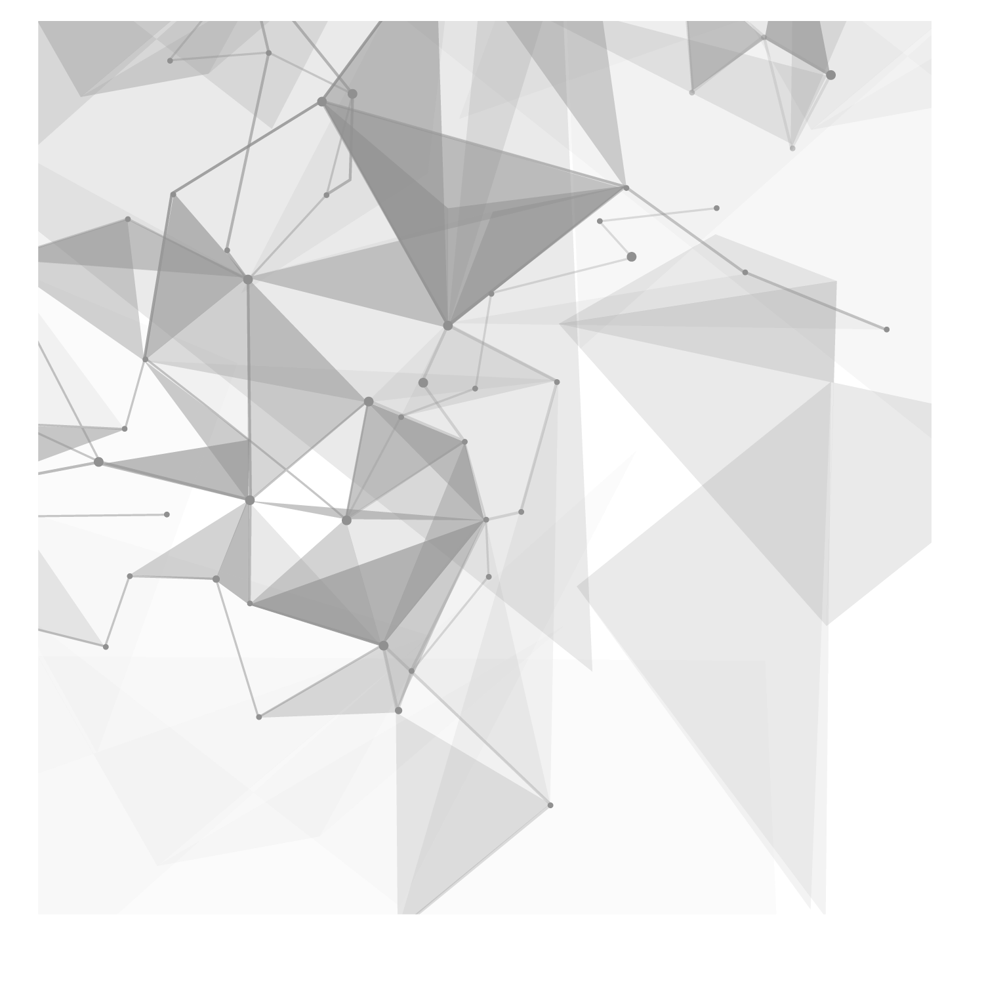

From
ZERO
ALESSANDRO BERTI

Slide 3



A Bit
Bit
01010101010101111110010011001010101010100101010100101010101010101000100000101101010101010101010101111110101010100110101010101
….
010100000000001011111111111111110101010101010101010101010101010101010101010101101001100011010101011010101010101101010101010110101
0
1

Slide 4
Dimensions
Bits
Bytes
Kilobytes
Megabytes
Gigabytes
Terabytes
Petabytes
Exabytes
Zettabytes
Yottabytes
8 × 1 000 000 Bits
A photo
Notes:
I’ll do my best to talk about it in the most plain and clear way.

Slide 5
Dimensions
Bits
Bytes
Kilobytes
Megabytes
Gigabytes
Terabytes
Petabytes
Exabytes
Zettabytes
Yottabytes
A film
Notes:
I’ll do my best to talk about it in the most plain and clear way.

Slide 6
Dimensions
Bits
Bytes
Kilobytes
Megabytes
Gigabytes
Terabytes
Petabytes
Exabytes
Zettabytes
Yottabytes
1000 x
Notes:
I’ll do my best to talk about it in the most plain and clear way.

Slide 7


Dimensions
Bits
Bytes
Kilobytes
Megabytes
Gigabytes
Terabytes
Petabytes
Exabytes
Zettabytes
Yottabytes
All human speech ever spoken
42 Zettabytes
(42 trillion of films)
Notes:
http://highscalability.com/blog/2012/9/11/how-big-is-a-petabyte-exabyte-zettabyte-or-a-yottabyte.html

Slide 8
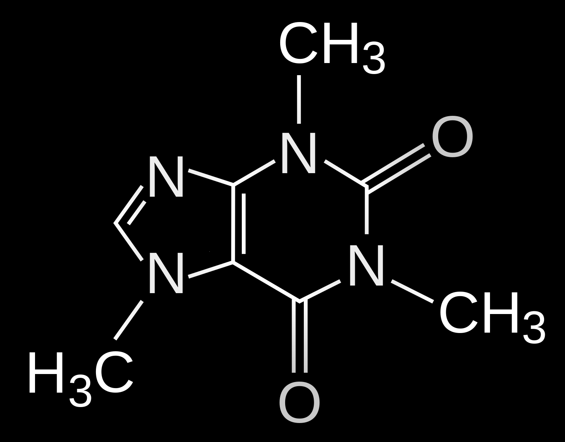
Dimensions
Bits
Bytes
Kilobytes
Megabytes
Gigabytes
Terabytes
Petabytes
Exabytes
Zettabytes
Yottabytes
Caffeine Molecule
10²³ Yottabytes
(10²³ quatrillions of films)
Notes:
http://highscalability.com/blog/2012/9/11/how-big-is-a-petabyte-exabyte-zettabyte-or-a-yottabyte.html

Slide 9
SUPERPOSITION
0
Classical Bit
Quantum Bit
1
0
1
a.k.a “qubit”

Slide 10
How many qubits?
Caffeine Molecule
160 qubits
2¹⁶⁰ bits = 10²³ Yottabytes
= 10²³ quatrillions of films
Notes:
http://highscalability.com/blog/2012/9/11/how-big-is-a-petabyte-exabyte-zettabyte-or-a-yottabyte.html

Slide 11

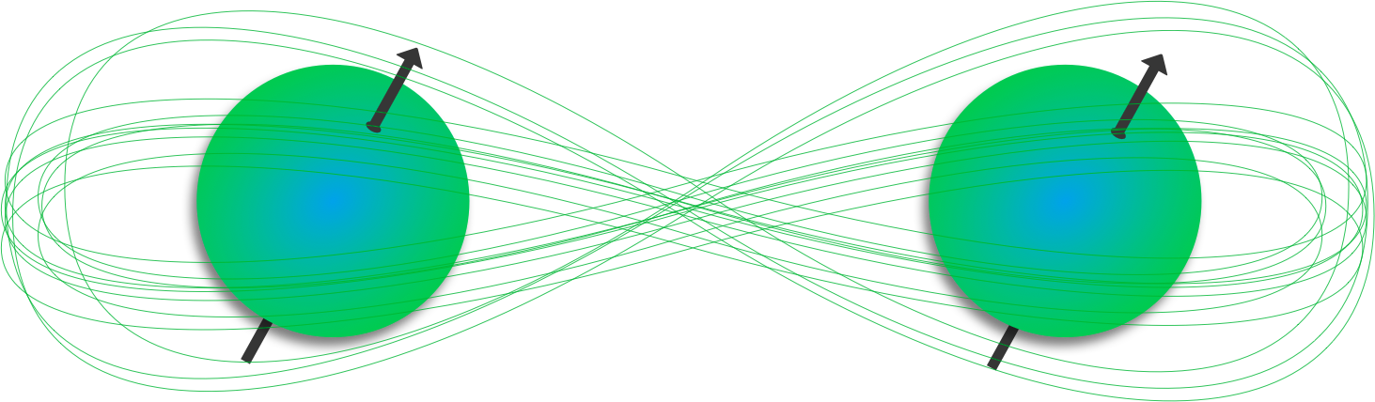
What is Quantum Computing?
Quantum computing is the use of quantum phenomena to perform computation
Two Quantum Phenomena
SUPERPOSITION
ENTANGLEMENT

Slide 12



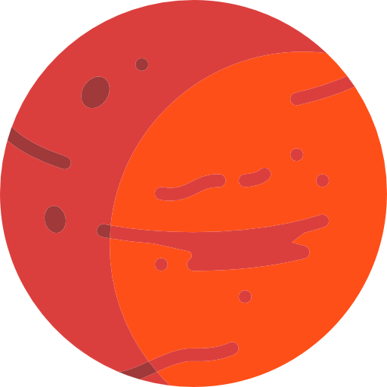
ENTANGLEMENT
ENTANGLE(Q1, Q2)
Q1
Q2
1
1
Q1
Q2

Slide 13
ENTANGLEMENT
ENTANGLE(Q1, Q2)
Q1
Q2
0
0
Q1
Q2

Slide 14
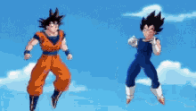
Again!
In entanglement, one constituent cannot be fully described without considering the other(s)
They cannot be anymore described as two distinct systems!
That’s what “entanglement” means.

Slide 15


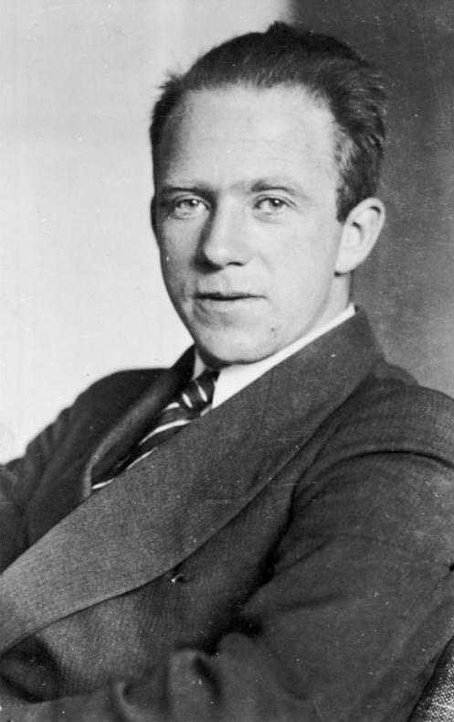



Fragility
We said that Quantum Computing deals with quantum phenomena, right?
BUT, quantum phenomena show themselves only at a “particle level” and
particles are very fragile!
Heisenberg’s Uncertainty Principle
“Observing” implies using light. Light produces heat, thus there is a transfer of energy!
Since the particle is very fragile, this energy “corrupts” its original state!
Notes:
Provide you the intuition

Slide 16
Measurements
That does not means that you cannot observe anything!
But simply that if you want to exploit quantum phenomena...
...you can’t do observations during computations.
You CAN measure only at the end of your quantum algorithm
The “measurement” collapses quantum data into classical one!

Slide 17

So?
It’s a kind of SUPER - PARALLELISM!
You can’t observe
what is happening
Step-by-step. There is no “if” or “for”
instruction
Classical Input
.
.
.
.
.
.
Classical Output
Qubit Encoding + Quantum Computation

Slide 18
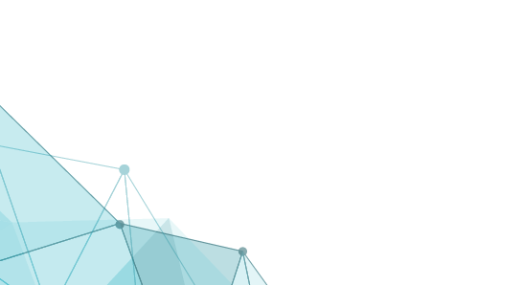

I’m going to impress you!
“Which is the complexity of searching an element in an unsorted dataset?”
O(n)
i.e. to find an element you need to scan the entire the dataset.
i.e. (x2) You need to know each element to answer correctly, right?
GROVER’S ALGORITHM (Quantum Algorithm)
O(√n)
i.e. Grover’s Algorithm finds the element without scanning the entire dataset!!
Don’t you think that is incredible?

Slide 19
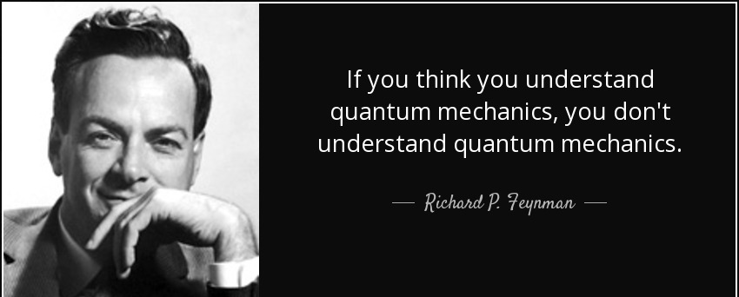
WHY?
These incredible quantum phenomena just happen.
No one knows why.

Slide 20
TO
CLASSIFICATION
ALESSANDRO BERTI

Slide 21

Distance Based Classifier
The Task:
Given 3 different training vectors
Given a test vector
What is the closest training vector to test one?

Slide 22
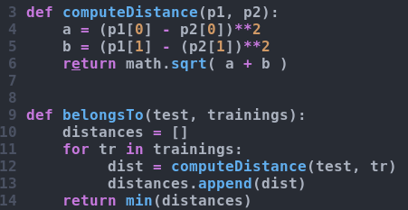
Key-Elements
You compute the distances between each training vectors and the test vector
(3 training vectors → 3 distances to compute)
Then you are able to establish which is the closest element to the test vector
CLASSICAL
QUANTUM
H
≃
High Abstraction Level
Very Low Abstraction Level

Slide 23
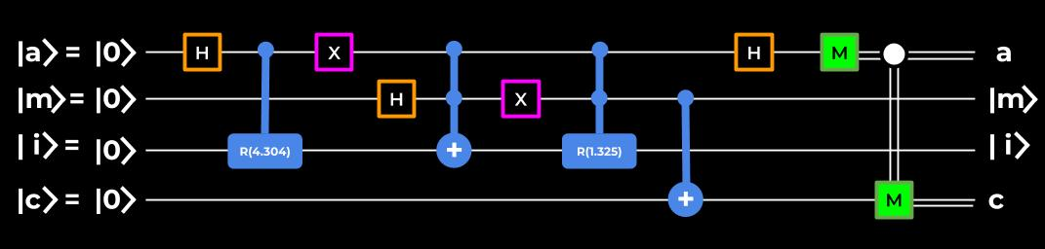
Quantum Distance Based Classifier (by Schuld, Fingerhuth, Petruccione)
Quantum Computing algorithms can be splitted in 3 phases:
Quantum Data Encoding
i.e. Encodes classical bits into quantum bits
Quantum Computation
i.e. Computes (such as computing distances)
Measurement
i.e. Converts the “quantum-solution” into the “classical one”

Slide 24
Quantum Data Encoding
Let’s try to understand what’s happening...
Load test vector
Load training_0
Load training_1
Notes:
Why tutti sul qubit |i>

Slide 25
Map in memory
Load test vector
Load training_0
Load training_1
Let’s try to visualize what is happening…

Slide 26
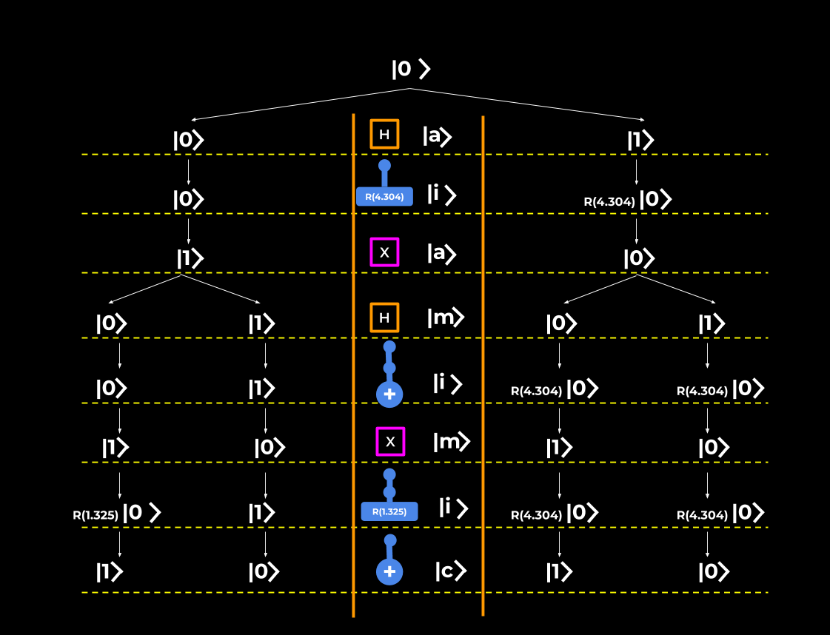
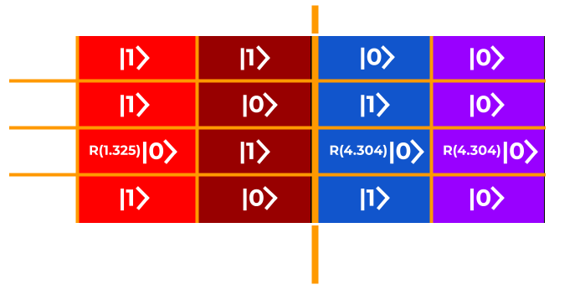
Visual Quantum Tree - Encoding
Training_1
Training_0
Test Vector
Test Vector

Slide 27
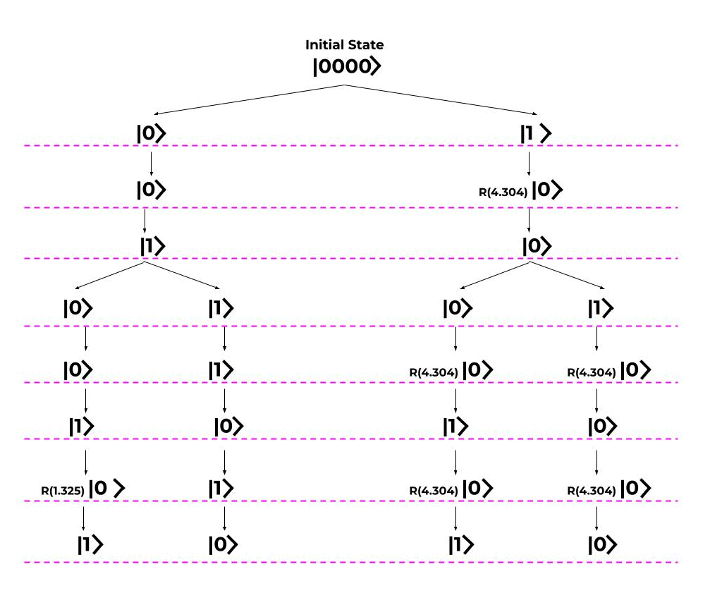
Visual Quantum Tree - Computing
The Hadamard Clashes/Compares:
Training_0 and Test (class 0)
Training_1 and Test (class 1)
In one single shot!
The Hadamard Effect

Slide 28
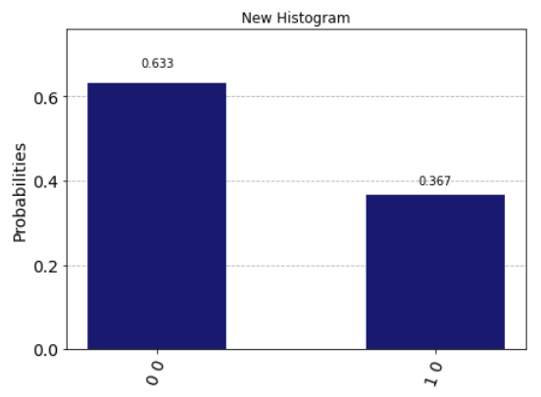
MEASUREMENT
What does it mean?
Short Story
The test belongs to class 0
The truth:
Running the algorithm 10 times:
6 times the algorithm classifies the test in class 0
4 times the algorithm classifies the test in class 1

Slide 29
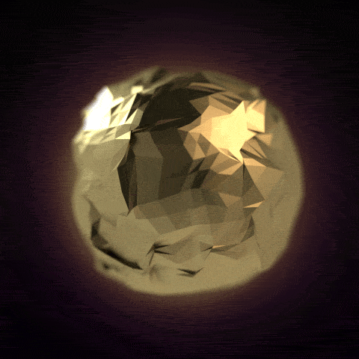
TODAY
“ALL THAT GLITTERS IS NOT GOLD”
a.k.a. “Non è tutto oro ciò che luccica”
Quantum Computers suffers from the “decoherence problem”
i.e. qubits gets corrupted very quickly
The deeper the circuit, the more unreliable the qubits are.
The encoding phase “deeps” the circuit a lot → decoherence

Slide 30






QUESTION TIME!
in/aleberti
Brotherhood94
Brotherhood94
Brotherhood94
alessandro.berti@phd.unipi.it
Notes:
Usato in tandem

